Slide 1
The Earlier the cheaper? Houston rockets tickets analysis
Frank Li
SMGT 490
April 17th, 2019

Slide 2

Mentor
Winston Lin
Director of Business Strategy & Analytics, Houston Rockets

Slide 3

Data
16-17 to 18-19 transaction records (~5 million records)
Both primary market and secondary market (Flash Seats)

Slide 4
Factors that Influence Ticket Price
Seat Position
Opponent
Match Time (Month, Day/Night, Holidays)
When to buy tickets (Days to Event)
Team Performance
Peer Event (Texans, Astros)

Slide 5
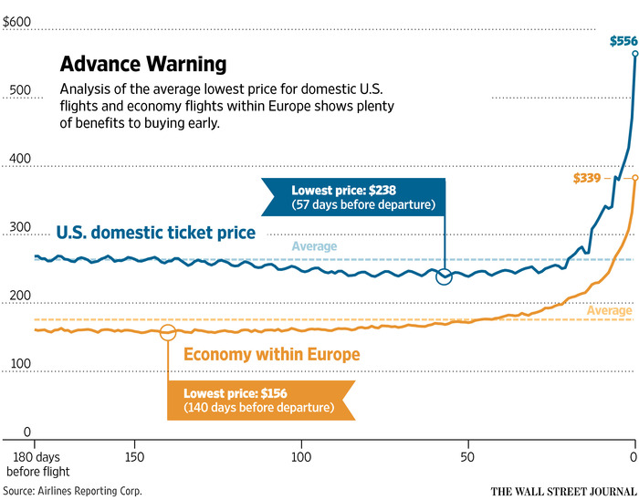
Assumptions
Similar with airplane tickets
Days to event -- → Price ++

Slide 6
method
Jupyter Notebook (Python)
Numpy, Pandas, Matplotlib, Sklearn
Controlled variable: section
Independent variable: days to event
Dependent variable: price
Compute avg. price for each section
Create a nested map: {section: {days to event: price}}
Regression & modeling

Slide 7
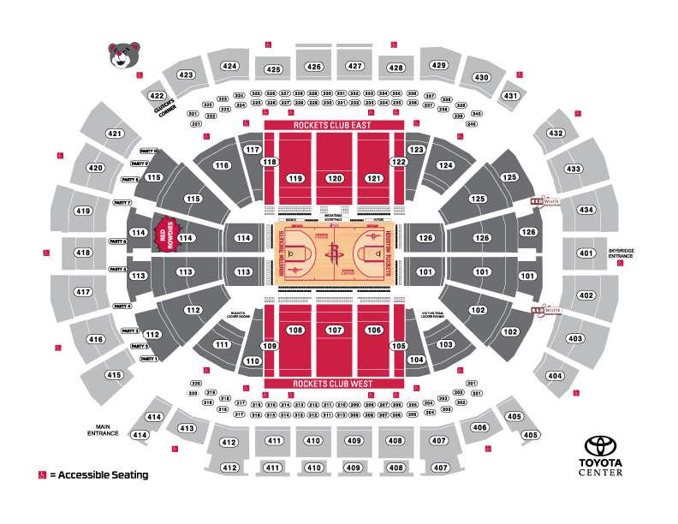
Upper Sideline
Club
Lower Endzone
Upper Endzone
Upper Endzone
Club
Lower Corner
Premium (courtside, ledge dining, VIP)
Upper Sideline

Slide 8
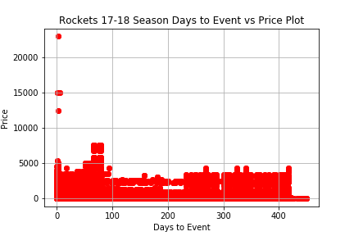
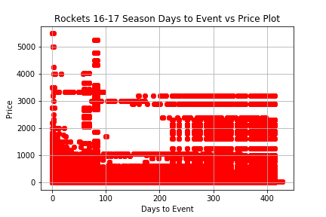
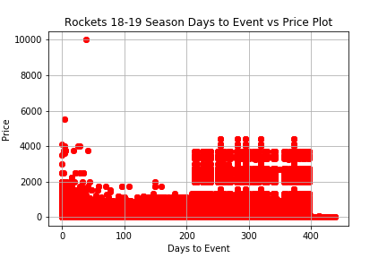
First look

Slide 9
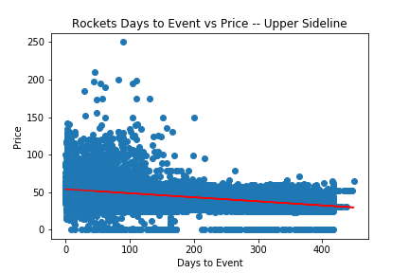
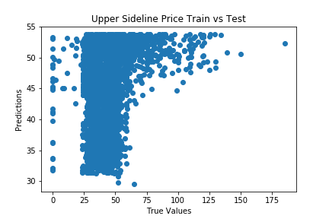
Upper Sideline
y = -0.054x + 53.82
Prediction score = 0.172

Slide 10
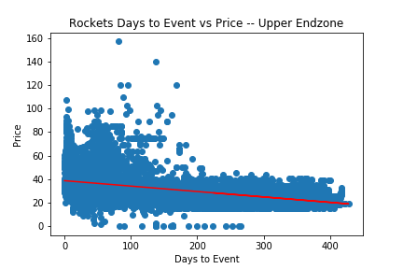
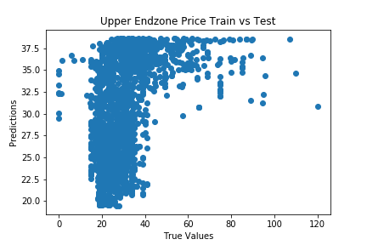
Upper Endzone
y = -0.046x + 38.68
Prediction score = -0.521

Slide 11
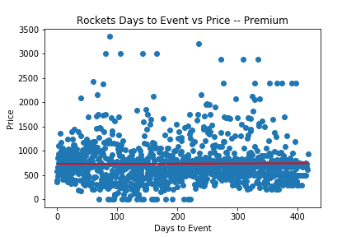
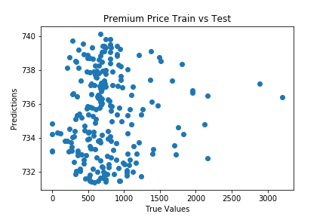
Premium
y = 0.021x+ 731.4
Prediction score = -0.002

Slide 12
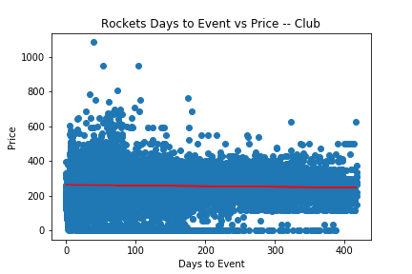
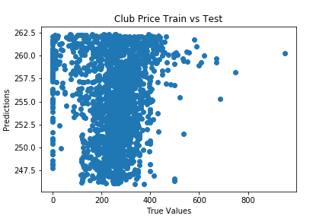
CLUB
y = -0.039x + 262.4
Prediction score = -0.003

Slide 13
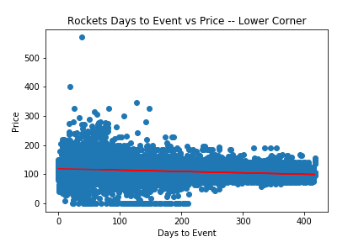
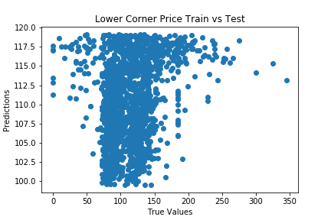
Lower Corner
y = -0.047x + 119.15
Prediction score = 0.028

Slide 14
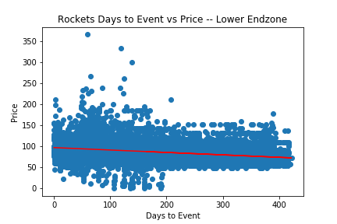
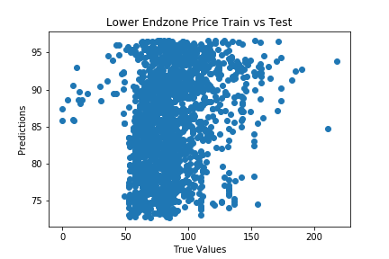
Lower Endzone
y = -0.058x + 96.7
Prediction score = 0.067

Slide 15
Coefficient
From high to low in terms of absolute values:
Lower Endzone
Upper Sideline
Lower Corner
Upper Endzone
Club
Premium (positive)
Generally not hugely significant alone

Slide 16
Modeling Score
Upper Sideline
Lower Endzone
Lower Corner
Premium
Club
Upper Endzone

Slide 17
conclusion
Weak relationship standing alone
Proves assumption
Take other factors into regression would make the model much more accurate
Difficulty: how to quantify seat location advantage, how to rank opponent
Ideal outcome: given Days to Event, Section and Opponent, output “standard” prize

